Slide 1

Title: Restaurant Competitor Price Watcher
Student Name: k. Sandhya
Student ID: 2520030473
Cluster: 4
Section: 16
Under the Guidance
of
Supervisor Name: Mrs Surekha
Assistant Professor
Department of CSE

Slide 2
OUTLINE
Abstract
Existing System
Proposed System
System Architecture
Project Modules
Objectives
Co’s Attainments - FWD
Co1
Co2 …….. 5. Co5
Co’s Attainments - DSA
Co1
Co2 …….. 5. Co5
Screen Shots for FWD & DSA
Conclusion
Geo-Tagged Photos

Slide 3
Abstract
Restaurant Competitor Price Watcher is a web application developed using HTML, CSS, and JavaScript.
It helps restaurant owners compare their dish prices with competitor prices.
The system calculates the average price and gives price suggestions.
It also shows price visualization using bars.
An admin panel allows adding new dishes and competitor prices.
The system uses JavaScript and browser local storage to manage data.

Slide 4
Existing System
In the existing system, restaurant owners usually analyze competitor prices manually. They collect information from different restaurants and compare prices using spreadsheets or manual calculations.
Problems in existing system:
Time-consuming process
Manual calculation errors
No automatic suggestions
Difficult to maintain large price data
No visualization of competitor prices

Slide 5
Proposed System
The proposed system provides an automated web-based solution for analyzing restaurant dish prices.
Features:
User login and signup system
Dish price comparison with competitors
Automatic average price calculation
Price suggestion system
Visualization of competitor prices using bars
Admin panel to add new dishes and prices

Slide 6
System Architecture
Built using HTML and CSS for login, analysis, and admin pages
Client Logic: JavaScript processes user input and performs price analysis.
Data Storage: Browser Local Storage stores user accounts and dish price data.
Output: System displays average price, suggestions, and price visualization to the user.

Slide 7
Project Modules
User Authentication Module: Handles login and signup.
Price Analysis Module: Compares user dish price with competitor prices.
Suggestion Module: Gives price recommendation based on average price.
Visualization Module: Displays competitor prices using bar charts.
Admin Module: Allows adding and managing dish price data.
Data Storage Module: Stores user and dish data using local storage.

Slide 8
Objectives
To develop a web-based system for restaurant price analysis.
To compare dish prices with competitor prices automatically.
To provide price suggestions based on average competitor prices.
To implement HTML, CSS, and JavaScript concepts in a real project.
To store and manage data using browser local storage.
To provide a simple and user-friendly interface for users.
To allow admins to add and manage dish price data easily.

Slide 9
Co’s Attainments - FWD
CO1: Implemented HTML structure and CSS styling to design the web interface.
CO2: Used HTML forms, input fields, and tables for user interaction and data input.
CO3: Applied JavaScript fundamentals such as variables, functions, conditions, arrays, and objects.
CO4: Implemented DOM manipulation, event handling, and local storage for storing user data.
CO5: Developed dynamic web pages and form validation using JavaScript for better interactivity.

Slide 10
Co’s Attainments - DSA
CO1: Applied algorithm analysis concepts for processing and comparing price data.
CO2: Used searching techniques to find dish prices from competitor data.
CO3: Implemented arrays and data structures to store competitor price information.
CO4: Used basic algorithm logic to calculate average prices and compare values.
CO5: Demonstrated problem-solving using data structures and algorithms in price analysis.

Slide 11
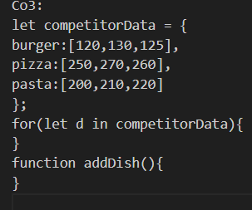
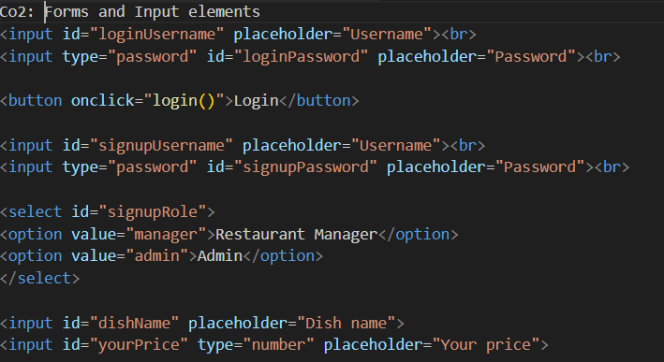
Screenshots for FWD & DSA

Slide 12
Conclusion
The Restaurant Competitor Price Watcher helps analyze and compare dish prices with competitor prices.
The system calculates average price and provides price suggestions.
It reduces manual effort in price comparison.
The project demonstrates the use of HTML, CSS, JavaScript, and basic DSA concepts.
It provides a simple and user-friendly interface for price analysis.

Slide 13
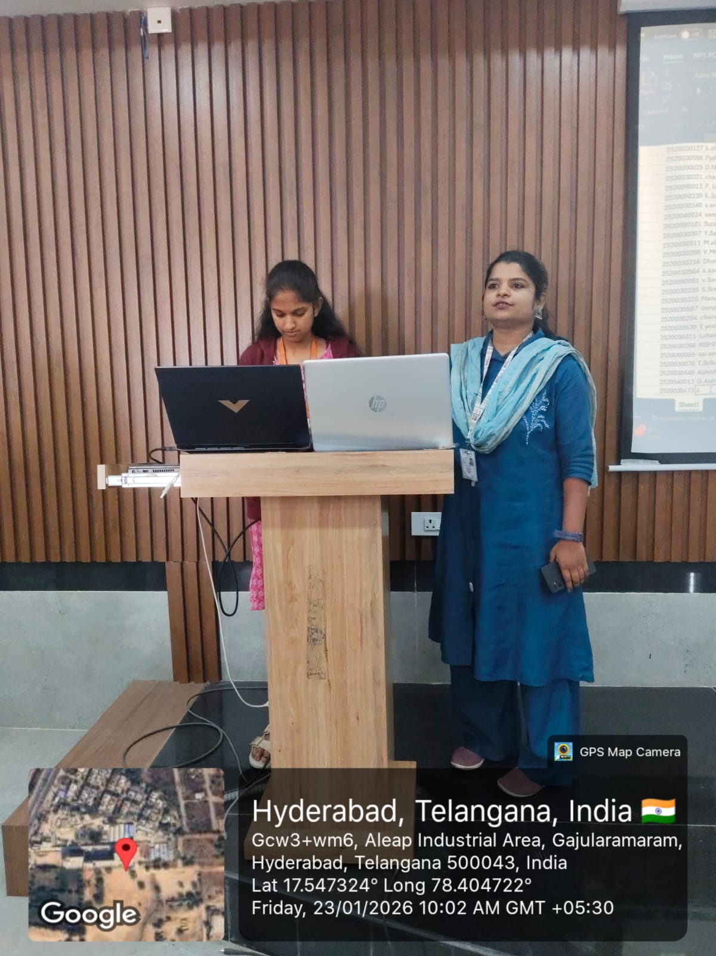
Geo- Tag Photos

Slide 14
THANK YOU

